Slide 1





JOSEPHUS
PROBLEM
(The last man
Standing)
Presentation by :- Ayush Vikram Singh, Shobhit Raj and Souparno Ghose

Slide 2
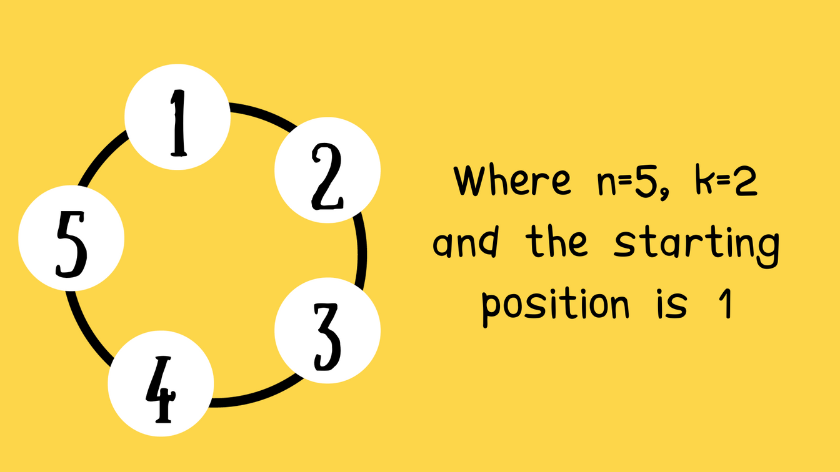
Abstract
Josephus's Problem is a counting-out game featuring a circle elimination algorithm. In this puzzle, n people are arranged in a circle, and counting begins from a designated point .You eliminate every kth person in a circle until only one remains..

Slide 3
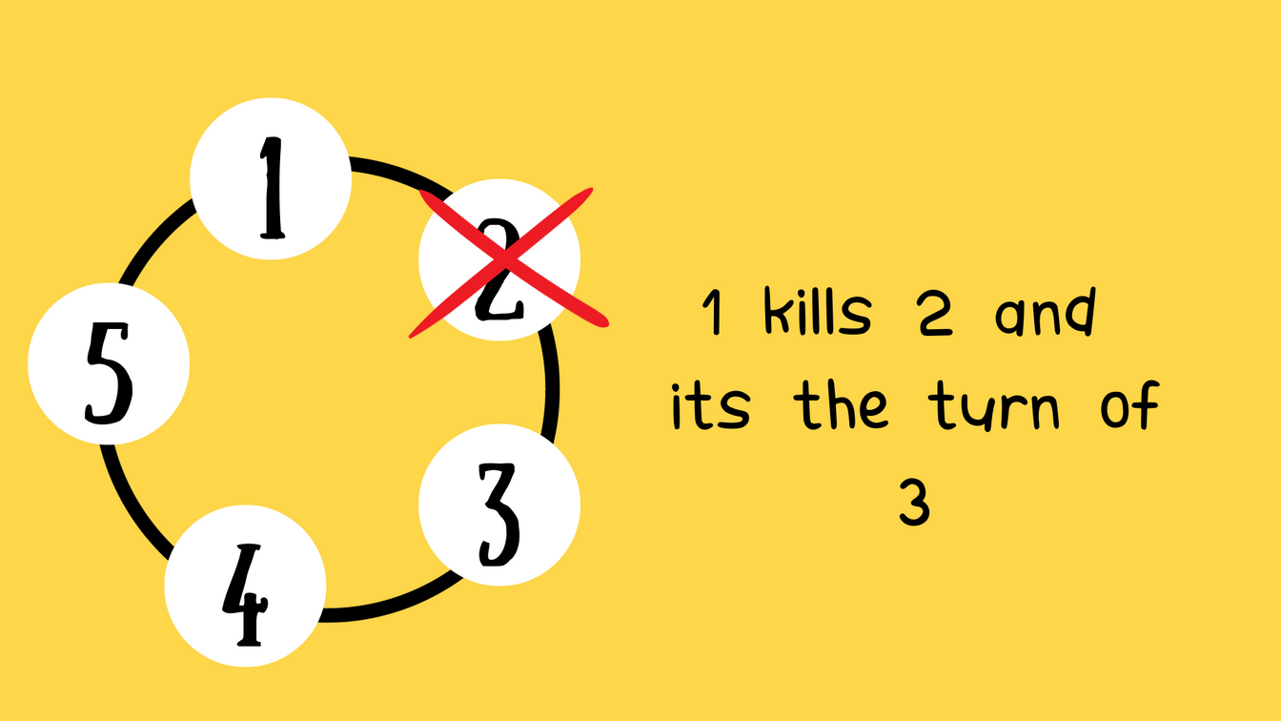
Abstract
Josephus's Problem is a counting-out game featuring a circle elimination algorithm. In this puzzle, n people are arranged in a circle, and counting begins from a designated point .You eliminate every kth person in a circle until only one remains..

Slide 4
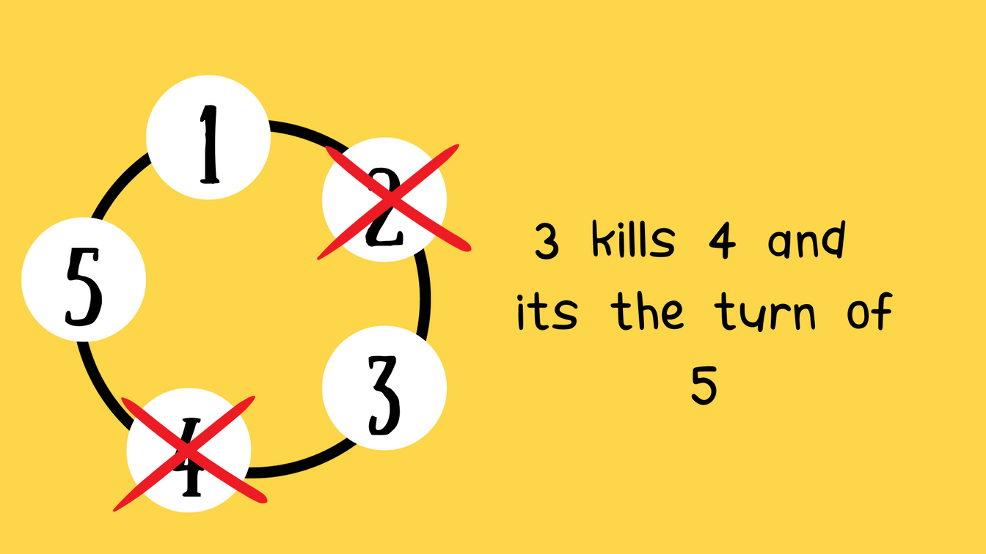
Abstract
Josephus's Problem is a counting-out game featuring a circle elimination algorithm. In this puzzle, n people are arranged in a circle, and counting begins from a designated point .You eliminate every kth person in a circle until only one remains..

Slide 5
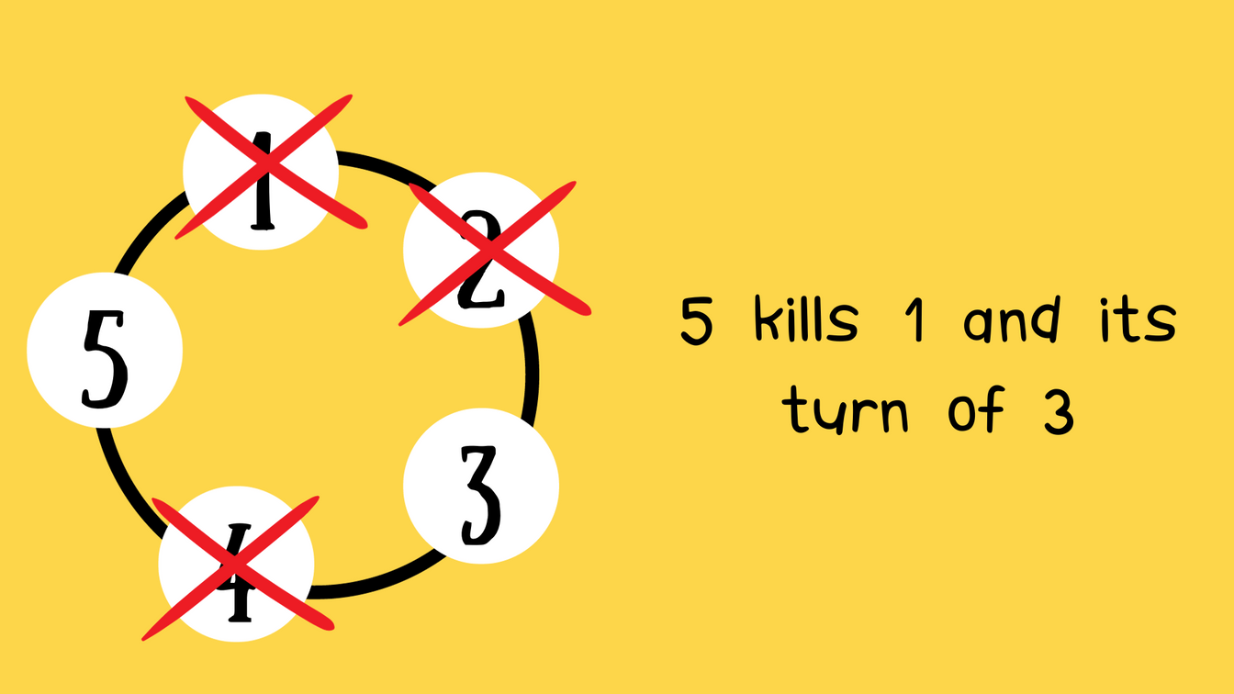
Abstract
Josephus's Problem is a counting-out game featuring a circle elimination algorithm. In this puzzle, n people are arranged in a circle, and counting begins from a designated point .You eliminate every kth person in a circle until only one remains..

Slide 6
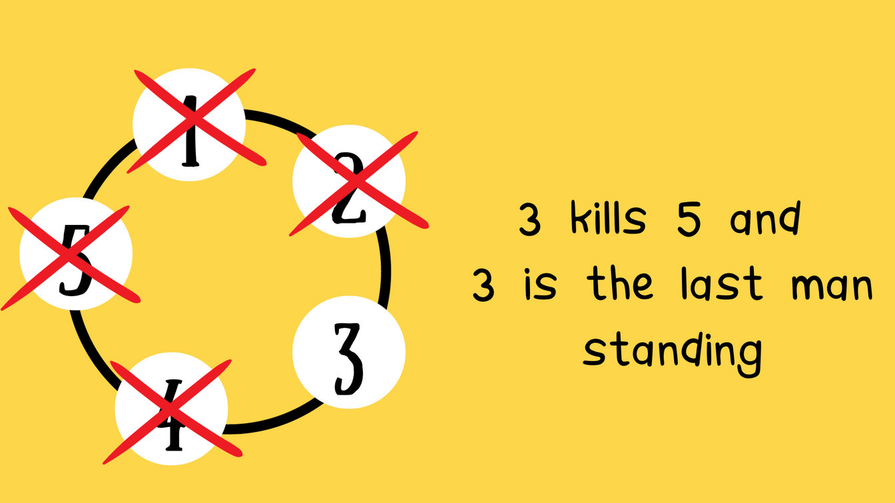
Abstract
Josephus's Problem is a counting-out game featuring a circle elimination algorithm. In this puzzle, n people are arranged in a circle, and counting begins from a designated point .You eliminate every kth person in a circle until only one remains..

Slide 7
SPECIAL CASE ABOUT JOSEPHUS PROBLEM WHEN K=2

Slide 8

Winning
Position
Winning
Position
1 | 1
2 | 1
3 | 3
4 | 1
5 | 3
6 | 5
7 | 7
8 | 1
9 | 3
10 | 5
11 | 7
12 | 9
13
N soldiers
W(n)
N soldiers
W(n)
Can You Guess
What will be
the winning position
for 13

Slide 9
Winning
Position
Winning
Position
1 | 1
2 | 1
3 | 3
4 | 1
5 | 3
6 | 5
7 | 7
8 | 1
9 | 3
10 | 5
11 | 7
12 | 9
13 | 11
14 | 13
15 | 15
16 | 1
17 | 3
18 | 5
N soldiers
W(n)
N soldiers
W(n)

Slide 10
Winning
Position
Winning
Position
1 | 1
2 | 1
3 | 3
4 | 1
5 | 3
6 | 5
7 | 7
8 | 1
9 | 3
10 | 5
11 | 7
12 | 9
13 | 11
14 | 13
15 | 15
16 | 1
17 | 3
18 | 5
N soldiers
W(n)
N soldiers
W(n)

Slide 11


Special case about Josephus problem when k=2
Fact 1: When n=2^a The winning position is always 1
Explanation: Every even position is eliminated until the (n−1)th person kills the nth person. As n is a power of 2, each round has an even number of people. Therefore, the person who starts the killing always survives because the process ensures the first person's turn to kill comes up every round until only one person remains.
1
Where n=4, k=2 and the starting position is 1
4
2
3

Slide 12

Special case about Josephus problem when k=2
Fact 1: When n=2^a The winning position is always 1
Explanation: Every even position is eliminated until the (n−1)th person kills the nth person. As n is a power of 2, each round has an even number of people. Therefore, the person who starts the killing always survives because the process ensures the first person's turn to kill comes up every round until only one person remains.
1
1 kills 2 and
its the turn of 3
4
2
3

Slide 13
Special case about Josephus problem when k=2
Fact 1: When n=2^a The winning position is always 1
Explanation: Every even position is eliminated until the (n−1)th person kills the nth person. As n is a power of 2, each round has an even number of people. Therefore, the person who starts the killing always survives because the process ensures the first person's turn to kill comes up every round until only one person remains.
1
3 kills 4 and
its the turn of 1
4
2
3

Slide 14
Special case about Josephus problem when k=2
Fact 1: When n=2^a The winning position is always 1
Explanation: Every even position is eliminated until the (n−1)th person kills the nth person. As n is a power of 2, each round has an even number of people. Therefore, the person who starts the killing always survives because the process ensures the first person's turn to kill comes up every round until only one person remains.
1
1 kills 3 and 1 is the last man standing
4
2
3

Slide 15
Special case about Josephus problem when k=2
Fact 2: When n=2a +L the winning position is 2*L+1
Explanation: Using the above fact, when 2a people are left in the circle, then the person who starts the killing survives. So, in this case, after l persons are killed, there are 2a people left in the circle, so the person whose chance will be to kill after killing l people will survive in the end. And the position at which it lands after killing l people will be 2*l+1.
.
1
7
2
Where n=7, k=2 and the starting position is 1
Here 7=2^2+3
so L=3
6
3
5
4

Slide 16
Special case about Josephus problem when k=2
Fact 2: When n=2a +L the winning position is 2*L+1
Explanation: Using the above fact, when 2a people are left in the circle, then the person who starts the killing survives. So, in this case, after l persons are killed, there are 2a people left in the circle, so the person whose chance will be to kill after killing l people will survive in the end. And the position at which it lands after killing l people will be 2*l+1.
.
1
7
2
1 kills 2 and its turn of 3
6
3
5
4

Slide 17
Special case about Josephus problem when k=2
Fact 2: When n=2a +L the winning position is 2*L+1
Explanation: Using the above fact, when 2a people are left in the circle, then the person who starts the killing survives. So, in this case, after l persons are killed, there are 2a people left in the circle, so the person whose chance will be to kill after killing l people will survive in the end. And the position at which it lands after killing l people will be 2*l+1.
.
1
7
2
3 kills 4 and its turn of 5
6
3
5
4

Slide 18
Special case about Josephus problem when k=2
Fact 2: When n=2a +L the winning position is 2*L+1
Explanation: Using the above fact, when 2a people are left in the circle, then the person who starts the killing survives. So, in this case, after l persons are killed, there are 2a people left in the circle, so the person whose chance will be to kill after killing l people will survive in the end. And the position at which it lands after killing L people will be 2*L+1.
.
1
7
2
since after killing
3 people its the
same case as fact 1
5 kills 6 and its turn of 7
6
3
5
4

Slide 19

Special case about Josephus problem when k=2
Fact 3: If n is expressed in binary, then last man is obtained by a one-bit left shift of the binary representation of n
n = (bm,bm−1...b1,b0)2 = bm2m + bm-12m-1 +…+b12 + b0 where bi ∈ 0,1 & bm= 1

Slide 20
Special case about Josephus problem when k=2
Fact 3: If n is expressed in binary, then last man is obtained by a one-bit left shift of the binary representation of n
Hence, when n is expressed as 2a+l then, a = m and
l = 0 + bm-12m-1 +…+ b12 + b0;
Therefore, l = (0,bm−1...b1,b0)2

Slide 21
Special case about Josephus problem when k=2
Fact 3: If n is expressed in binary, then last man is obtained by a one-bit left shift of the binary representation of n
Hence, 2*l = (bm−1...b1,b0,0)2 & 2*l+1 = (bm−1...b1,b0,1)2 which is the same as (bm−1...b1,b0,bm)2 as bm = 1
Therefore, the binary representation of the survivor position
is just one-bit left shift of the binary representation of n.

Slide 22
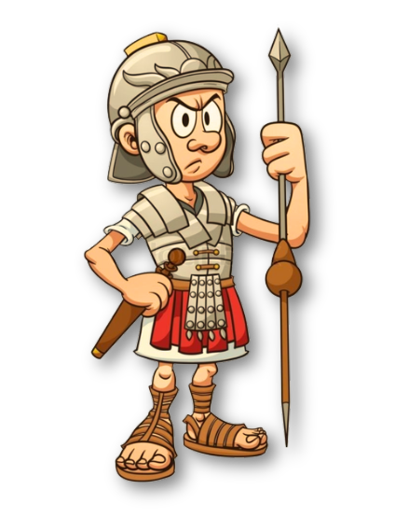
Historical Context
Legend has it that Josephus and 40 soldiers faced capture in a cave. To avoid surrender, they formed a circle and each man killed the person to his left until only one survived—Josephus, who strategically placed himself last to escape capture. This story inspired the Josephus Problem, a math puzzle where people in a circle are eliminated by a specific algorithm.

Slide 23
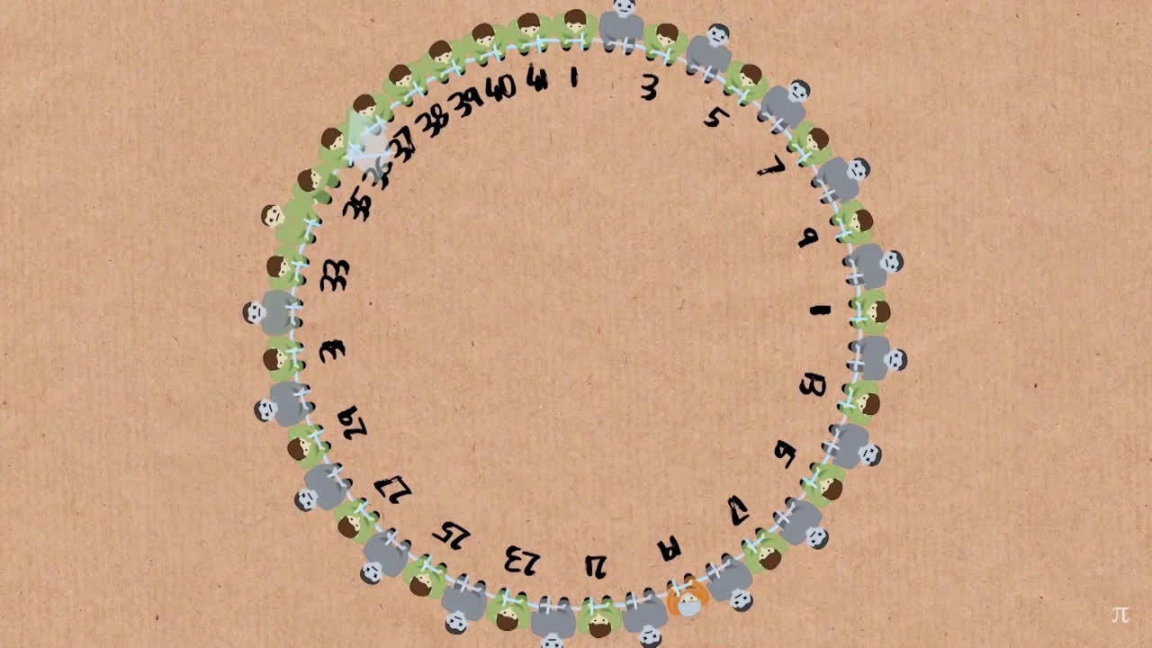

Slide 24
Now, we will explore how different elimination rules (such as varying n & k) and counting patterns affect the final survivor position using concepts of discrete mathematics.

Slide 25
Approaches to solve Josephus problem
Modular Arithmetic and Recursion
Graph Theory
To solve Josephus Problem we can do it by two ways:

Slide 26
Approach 1: Using Arithmetic and Recursion
Pseudocode
Time complexity
josephus(n,k)
{
if(n==1):
return 1
else:
return ((josephus(n-1,k)+k-1) % n+1
}
Due to the recursive calls, time complexity is O(n).
Space complexity
Determined by the depth of recursive calls, space complexity is O(n).

Slide 27
Approach 2: Using Graph theory
Pseudocode
Time complexity
The program iterates through the whole circular list to find the current position which takes O(n) time
This happens for n persons
Therefore, Time Complexity is O(n*n)
Josephus(n,k)
{
Create a circular linked list
Initialize a variable current to head (1st position in the circle)
Length = length(Circular List)
while(current->next != current):
Increment current by k - 1 (to find the k-th person)
Eliminate the person at index 'current' from the circular structure
set 'current' to the next person (node) in the list
return the last position as the survivor
}
Space complexity
The space complexity is determined
by the size of the circular linked list.
Therefore, it is O(n)

Slide 28
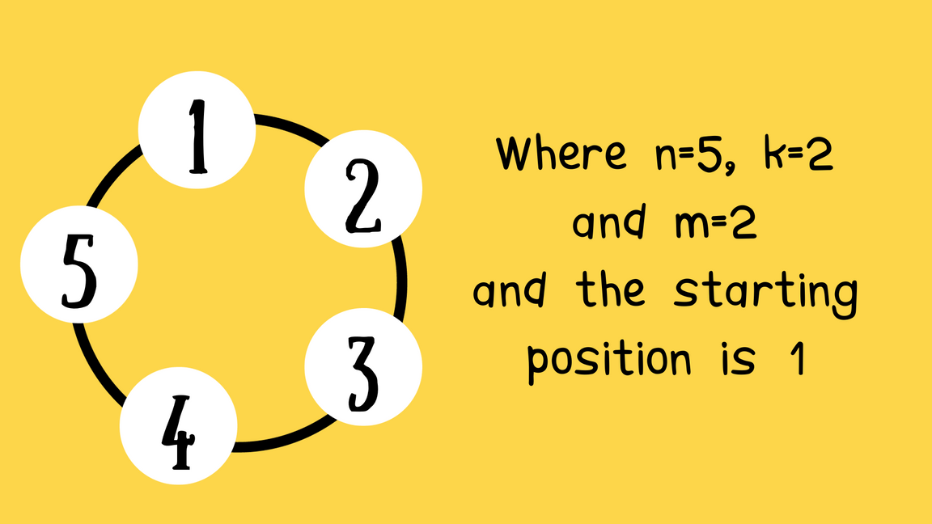
Variations of Josephus problem
1) Josephus Problem with Revivals
In this variant, after every (m)-th person is eliminated, the first person in the queue is revived and reintroduced into the circle at its original position.
Algorithm
The algorithm will be the same as implementation of graphical (circular linked list) solution of normal Josephus problem, just maintain a queue of eliminated people and after m eliminations, dequeue the first person from the queue and add it to its original position in the circle before elimination.

Slide 29

Variations of Josephus problem
1) Josephus Problem with Revivals
In this variant, after every (m)-th person is eliminated, the first person in the queue is revived and reintroduced into the circle at its original position.

Slide 30

Variations of Josephus problem
1) Josephus Problem with Revivals
In this variant, after every (m)-th person is eliminated, the first person in the queue is revived and reintroduced into the circle at its original position.

Slide 31
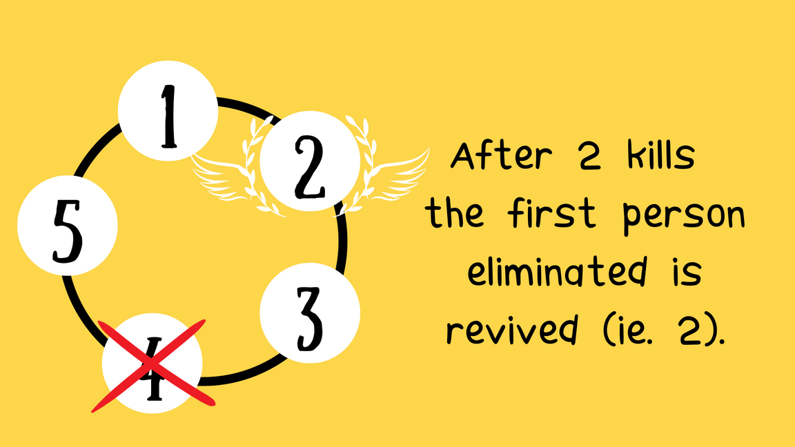
Variations of Josephus problem
1) Josephus Problem with Revivals
In this variant, after every (m)-th person is eliminated, the first person in the queue is revived and reintroduced into the circle at its original position.

Slide 32
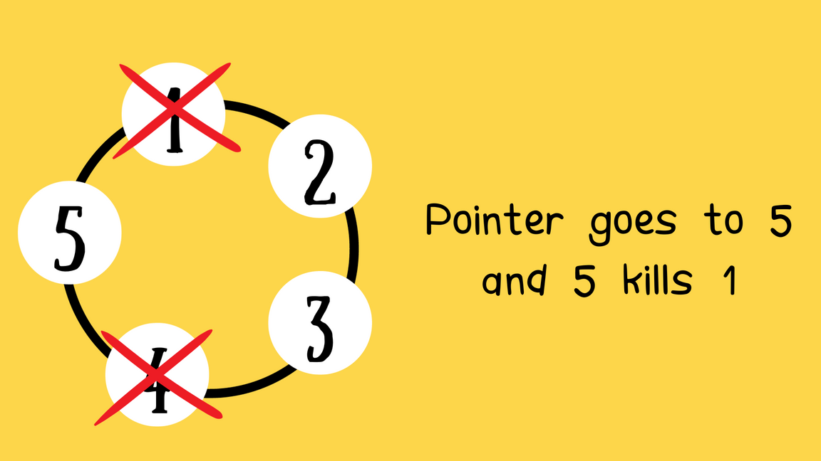
Variations of Josephus problem
1) Josephus Problem with Revivals
In this variant, after every (m)-th person is eliminated, the first person in the queue is revived and reintroduced into the circle at its original position.

Slide 33
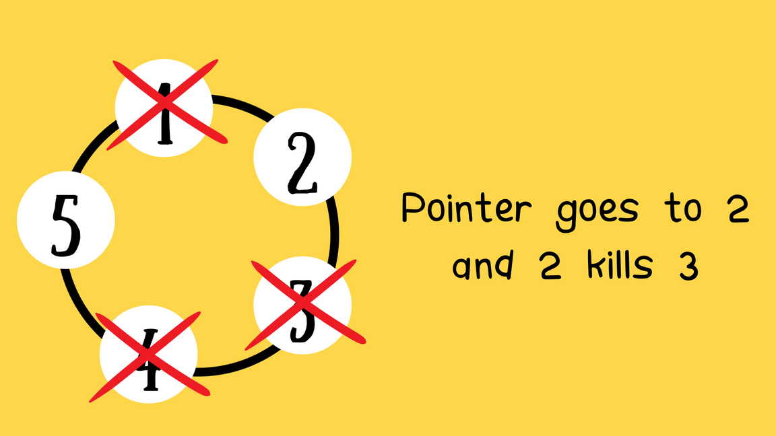
Variations of Josephus problem
1) Josephus Problem with Revivals
In this variant, after every (m)-th person is eliminated, the first person in the queue is revived and reintroduced into the circle at its original position.

Slide 34
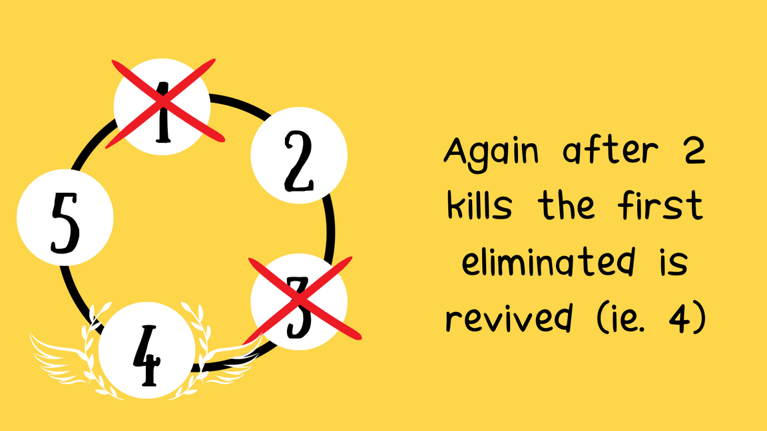
Variations of Josephus problem
1) Josephus Problem with Revivals
In this variant, after every (m)-th person is eliminated, the first person in the queue is revived and reintroduced into the circle at its original position.

Slide 35
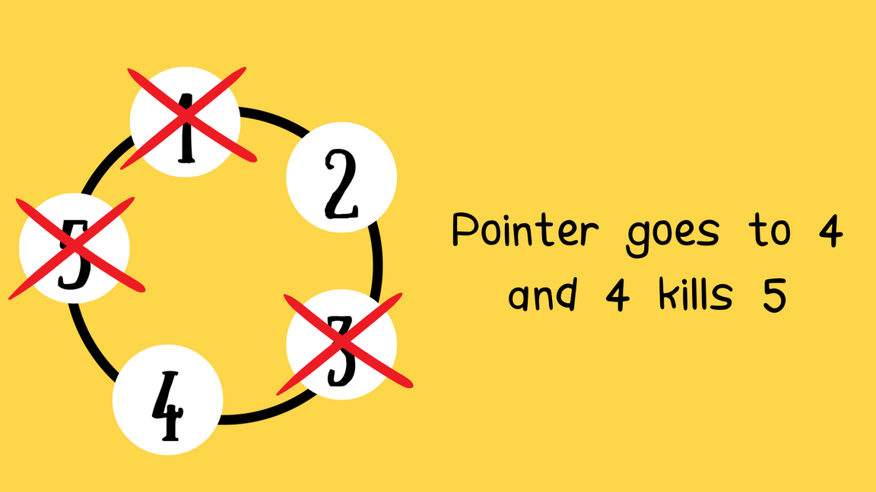
Variations of Josephus problem
1) Josephus Problem with Revivals
In this variant, after every (m)-th person is eliminated, the first person in the queue is revived and reintroduced into the circle at its original position.

Slide 36
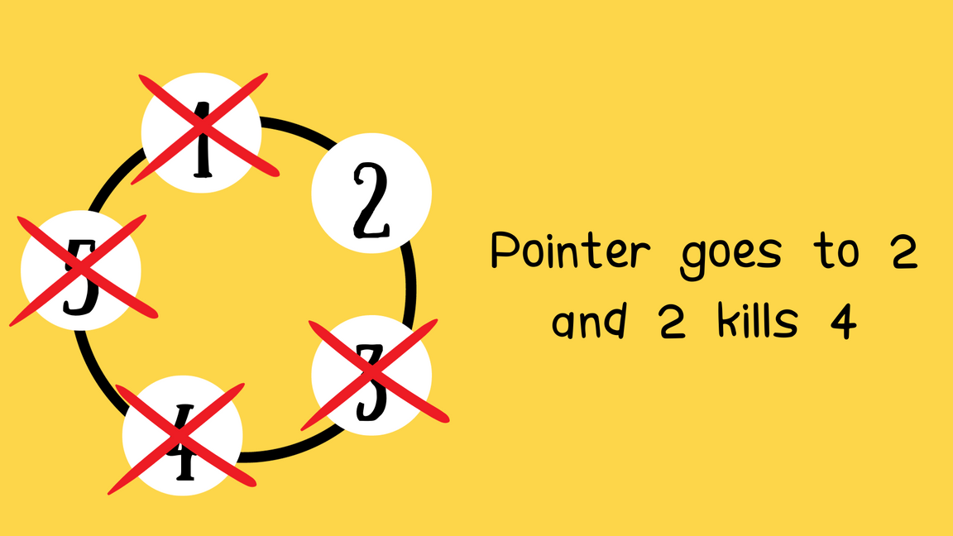
Variations of Josephus problem
1) Josephus Problem with Revivals
In this variant, after every (m)-th person is eliminated, the first person in the queue is revived and reintroduced into the circle at its original position.

Slide 37
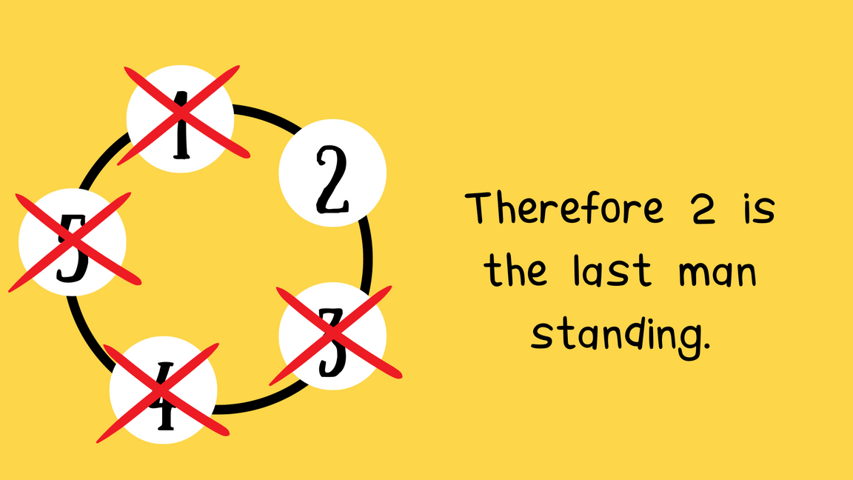
Variations of Josephus problem
1) Josephus Problem with Revivals
In this variant, after every (m)-th person is eliminated, the first person in the queue is revived and reintroduced into the circle at its original position.

Slide 38
Variations of Josephus problem
2) Josephus Problem in Multi Dimensional
The Multidimensional Josephus Problem expands the classic Josephus dilemma into multiple dimensions, entailing eliminations across various axes or structures. Unlike the original linear or circular arrangement, this variant involves intricate multi-dimensional setups with distinct elimination rules for each dimension.
Introduce elimination rules specific to each dimension, denoted by k_d, indicating the elimination step within that dimension.
The elimination process involves iterating through entities across all dimensions, eliminating individuals at the specified intervals based on the rules of each dimension.

Slide 39
Real-World Applications
Some real world applications of Josephus problem are:-
Resource Allocation in Systems: Resources can be distributed in a circular fashion by making a counting method to allocate the resources among the users.
Task Scheduling: It can be used for recurring tasks or processes.
Queue Management: Handling requests in a service center.

Slide 40
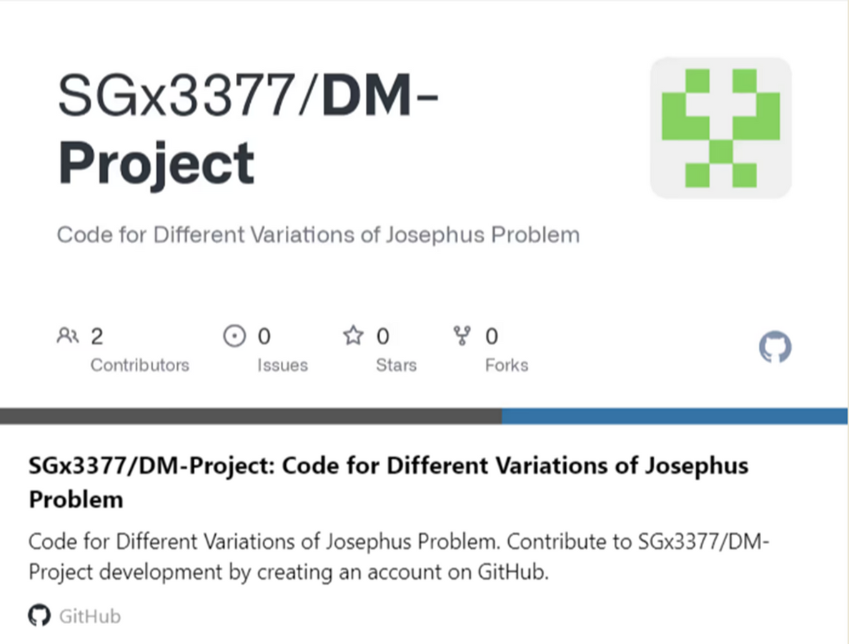
Code for different algorithms used in this project
GitHub link :
https://github.com/SGx3377/DM-Project.git

Slide 41
Conclusion
Our exploration into the Josephus Problem and its array of algorithmic variations has been an illuminating journey through the depths of mathematics and algorithmic methodologies. This ancient puzzle, centering around the survival of individuals arranged in a circular formation and facing sequential elimination, sparked our curiosity to delve into its multifaceted computational complexities. Our exploration didn't merely scratch the surface; instead, it delved into a spectrum of algorithmic approaches – from recursive models to iterative solutions – all aimed at deciphering the position of the final survivor within the circular structure.
Diving deeper into the problem's extensions and variations, we ventured into realms like the Josephus Problem with revivals, multidimensional expansions, circular permutations, and the integration of graph theory. These forays allowed us to dissect diverse computational strategies, unraveling the intricacies stemming from altered elimination rules, multi-dimensional constructs, and unique mathematical representations. Navigating through graph-based interpretations, permutation cycles, recurrence relations, and other facets of the problem, our exploration not only honed our problem-solving prowess but also underscored the interdisciplinary nature of mathematical challenges. This journey has affirmed that the Josephus Problem and its large number of variations serve as a fertile ground for exploration and innovation, embodying the essence of computational exploration across diverse domains.

Slide 42
Refrences
Cse547 DISCRETE MATHEMATICS Lecture 2 slides by Professor Anita Wasilewska
https://www3.cs.stonybrook.edu/~cse547/newLec2.pdf
“The Josephus Problem - Numberphile” youtube video featuring Daniel Erman from University of Wisconsin-Madison uploaded to channel “Numberphile”
https://www.youtube.com/watch?v=uCsD3ZGzMgE
Recurrence Relations and Their Solutions (Josephus Problem) by P Sam Johnson (NITK)
https://sam.nitk.ac.in/courses/MA201/Josephus_problem.pdf

Slide 43


